Slide 1

TREATMENT PLAN VIRTUALLY
PRESENTED BY
NIRAJ

Slide 2
INTRODUCTION
Organizing Treatment plans by Medical Doctors or Healthcare Professionals based on Patient details and Diagnosis symptoms through a digital interface.

Slide 3
ADVANTAGE OF PATIENTS AND HEALTHCARE SECTOR
Remote availability
Time-saving and comfortability
The patient can get treatment advice according to their comfortable time without mobilizing from their home places.
Cost-effective
Reduce the burdensome health problems in the country and W.H.O.
Healthcare professionals may advise and create treatment plans without physical presence, minimizing the hospital crowd.

Slide 4


Photo credited by Shutterstock

Slide 5
TKINTER
Tkinter is used to develop GUI (graphical user interface)
MYSQL
STORE DATA IN MySQL
DATABASE
SMTP for sending mail

Slide 6
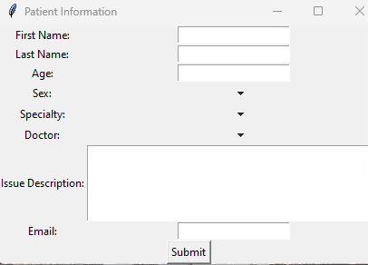

Slide 7
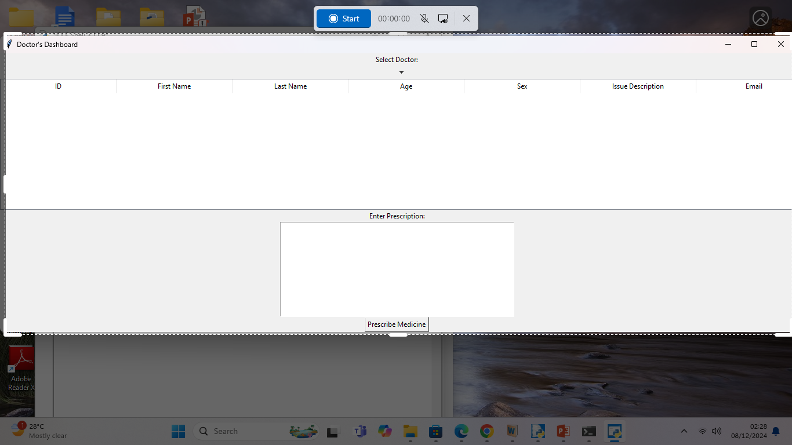

Slide 8
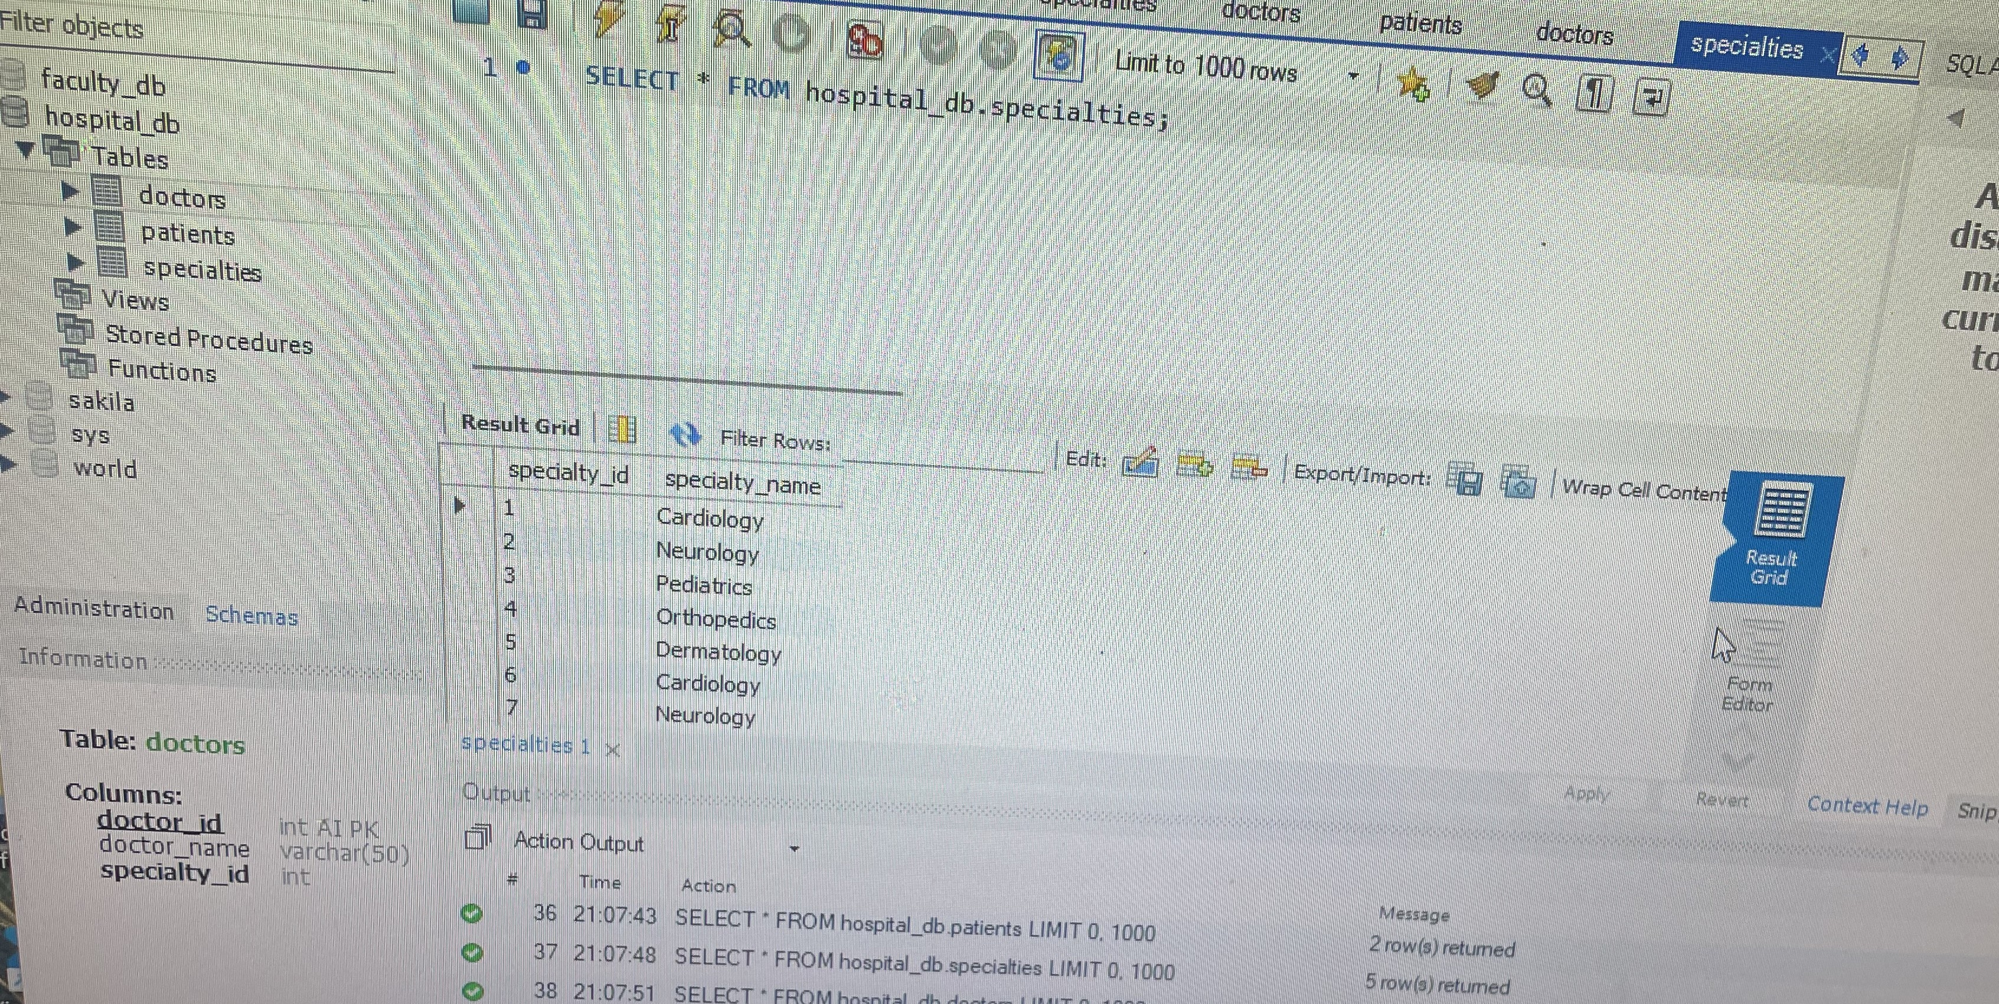
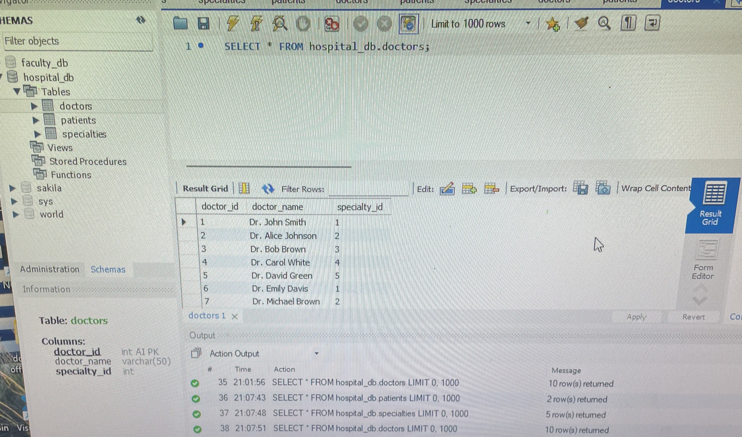
TO BE CONTINUED..

Slide 9
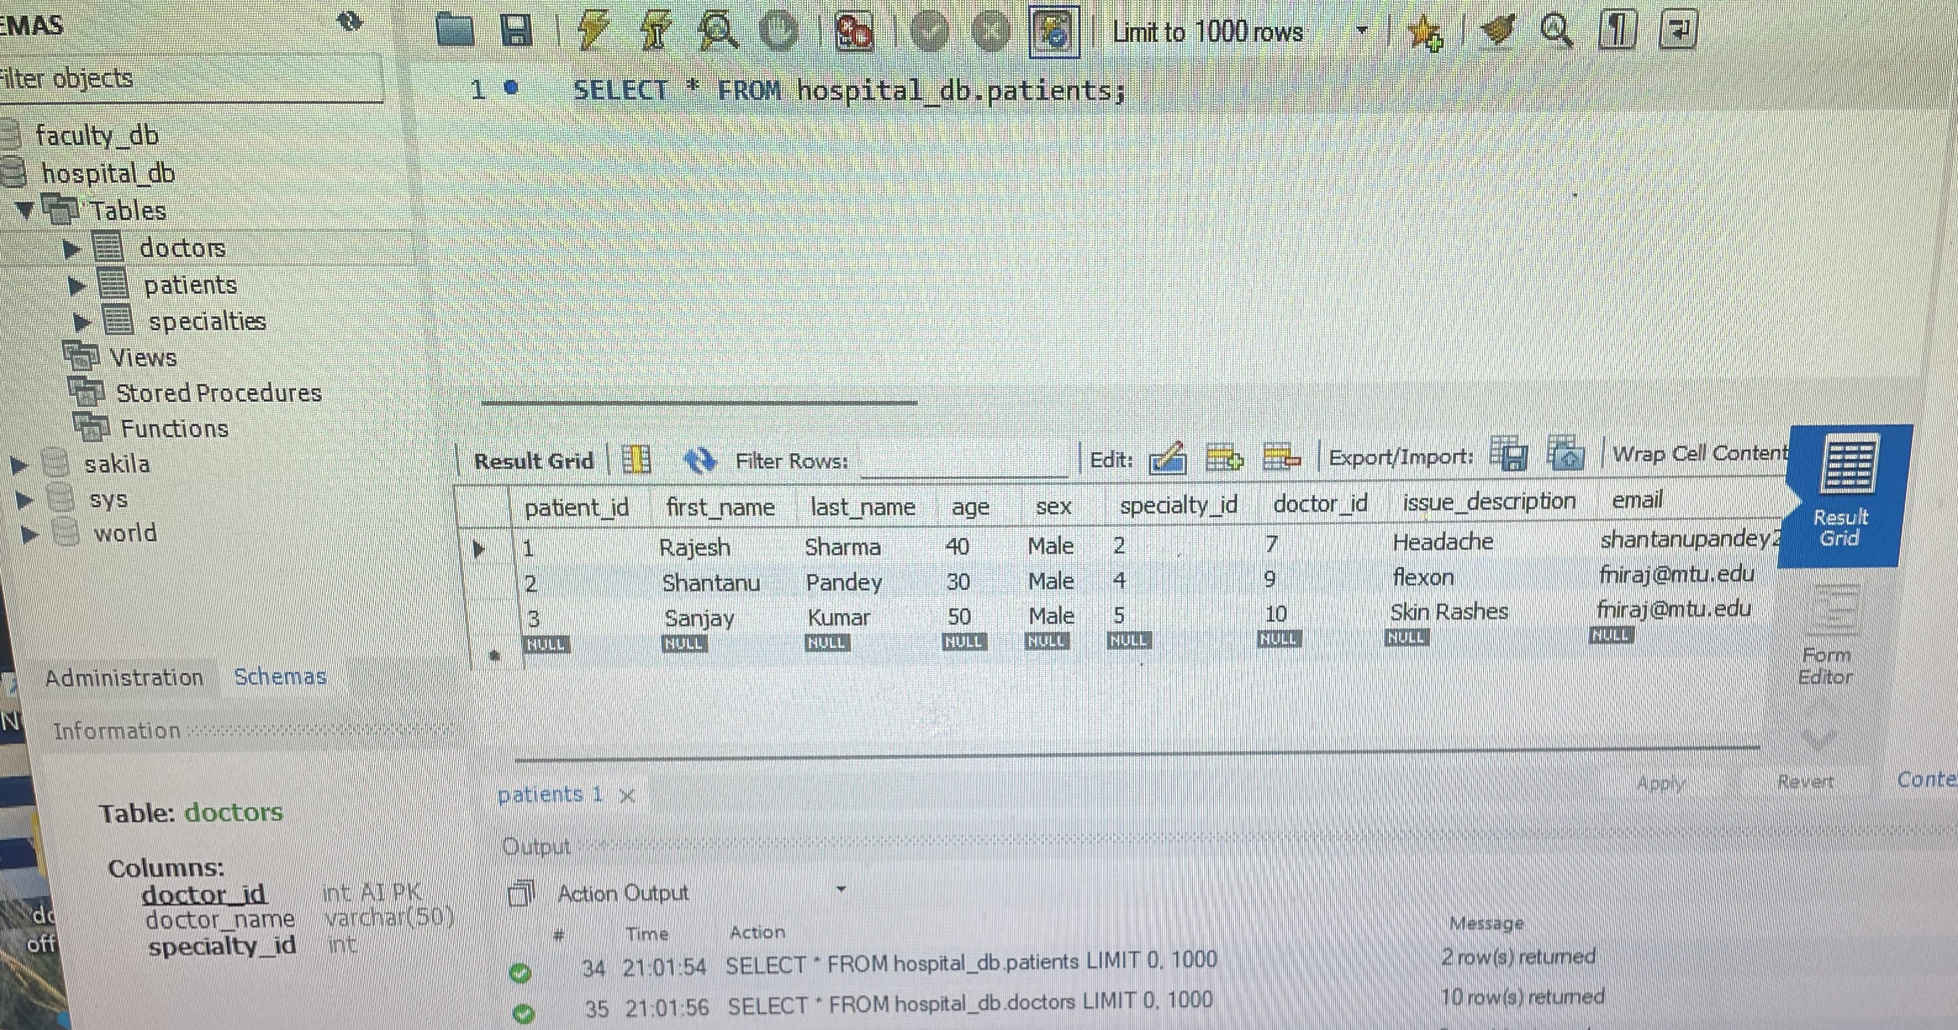
CONTINUED…

Slide 10
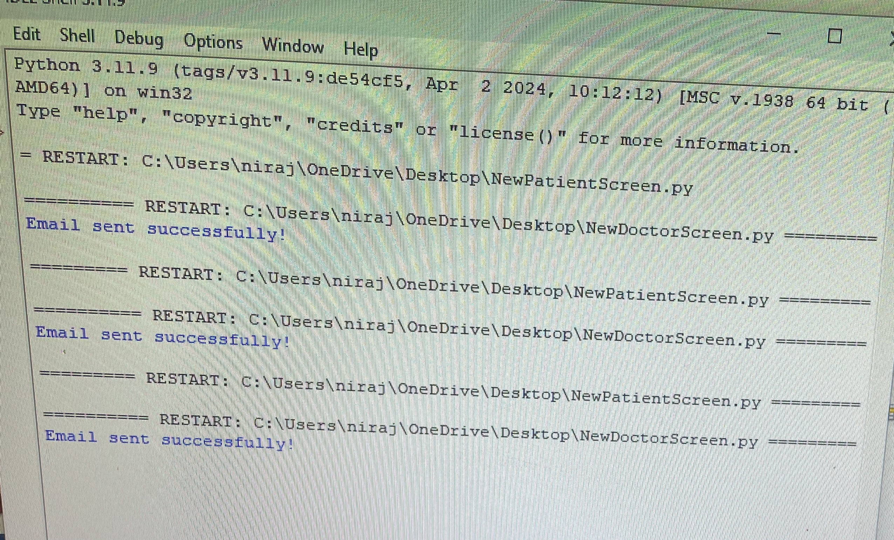
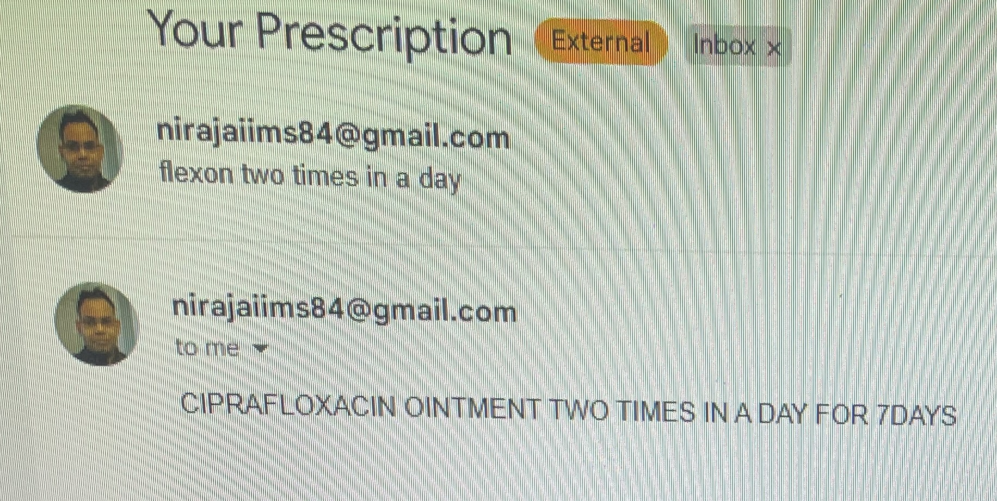
TO BE CONTINUED..

Slide 11
Thank you

